Slide 1
INSTACART DATA ANALYSIS
Bharadwaj Tippavajjula

Slide 2
Dataset Description
The dataset contains the orders from Date 1st May 2014 to June 2nd 2014. Total of 13845 unique orders and 963 orders have a complaint registered
Remaining 12,882 orders have missing complaint type. Of them 10805 orders are having rating of 5
7 types of complaints registered:
Poor Replacement
Poor Service
Item missing
Damaged or Spoiled
Wrong item
Other order issue
Item charged incorrectly
Null
Some of the orders have given 5 rating even when there is an complaint. This can be assumed to be a biased review by customer.

Slide 3
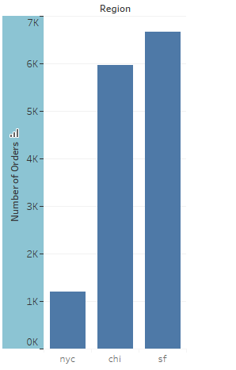
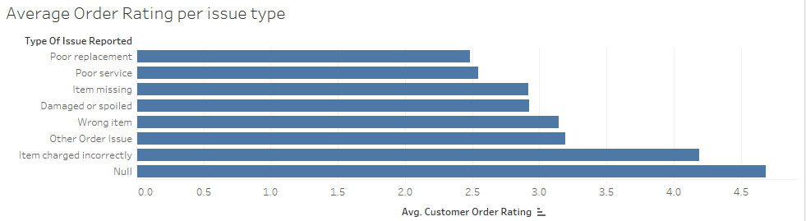
Initial Analysis and Observations
SF and Chicago seems to be top contributors to the business
Instacart might have recently launched its market in NYC
Poor replacement has the lowest average rating as the customer might be disappointed because, he already got a replacement item and the one that is replaced is disliked by customer
Average rating given by customers when they raised a complaint is approximately 3

Slide 4
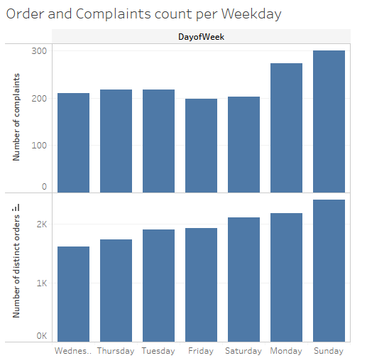
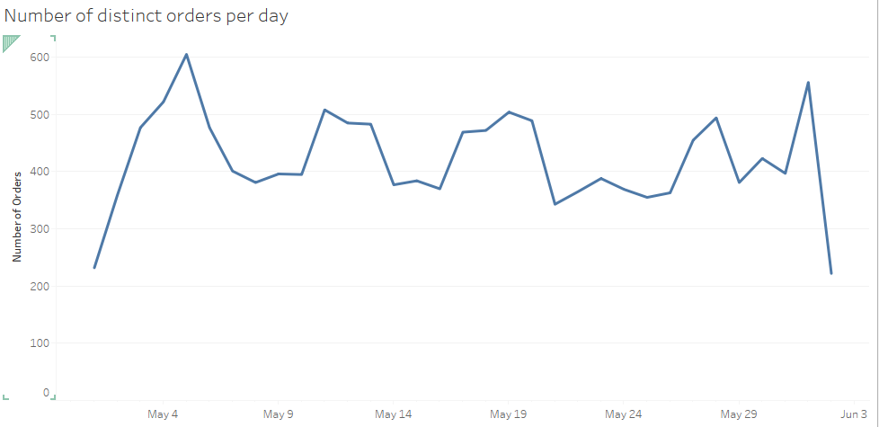
Analysis on Number of Orders
High number of orders during the start of month and on Sunday and Monday
Lower number of orders in the middle of the week

Slide 5
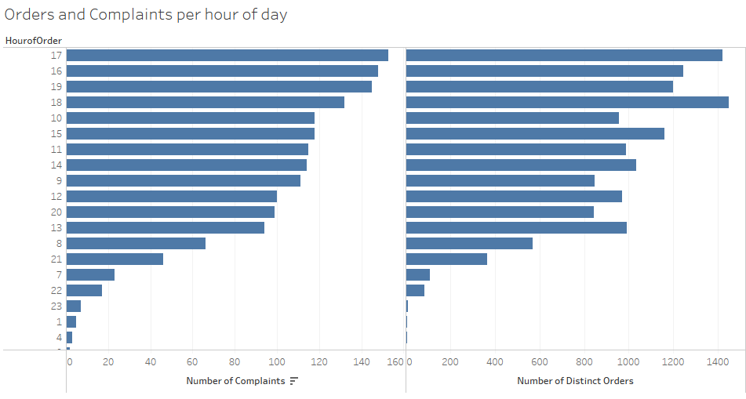
Analysis on number of complaints received – contd.
Number of orders are high during the evening hours from 4 PM to 7 PM hours
During the afternoon and morning hours their distributions remain the same
They are very less during the night

Slide 6
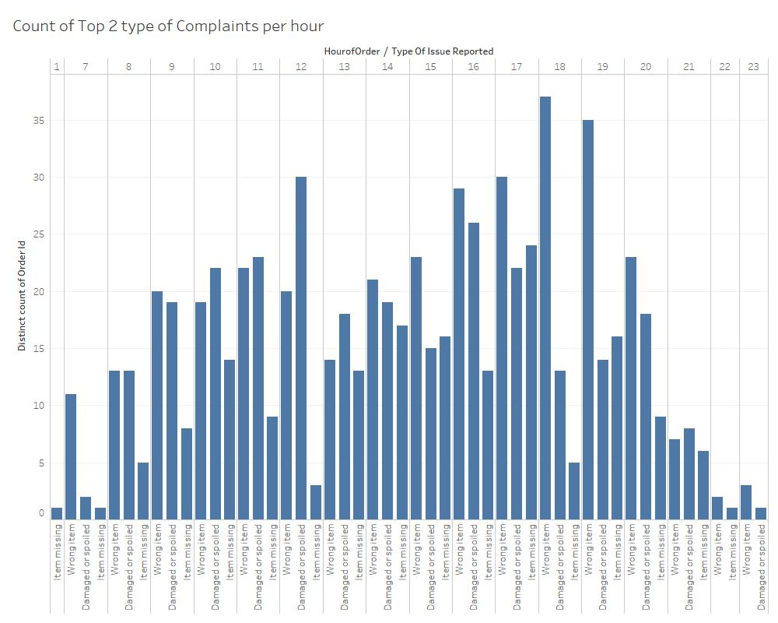
Analysis on number of complaints received – contd.
During the peak hours most of the complaints are of type
WRONG ITEM
DAMAGED ITEM
50 % of the total wrong item complaints are in the evening time
This can be because of higher number of orders per shoppers during the peak times

Slide 7
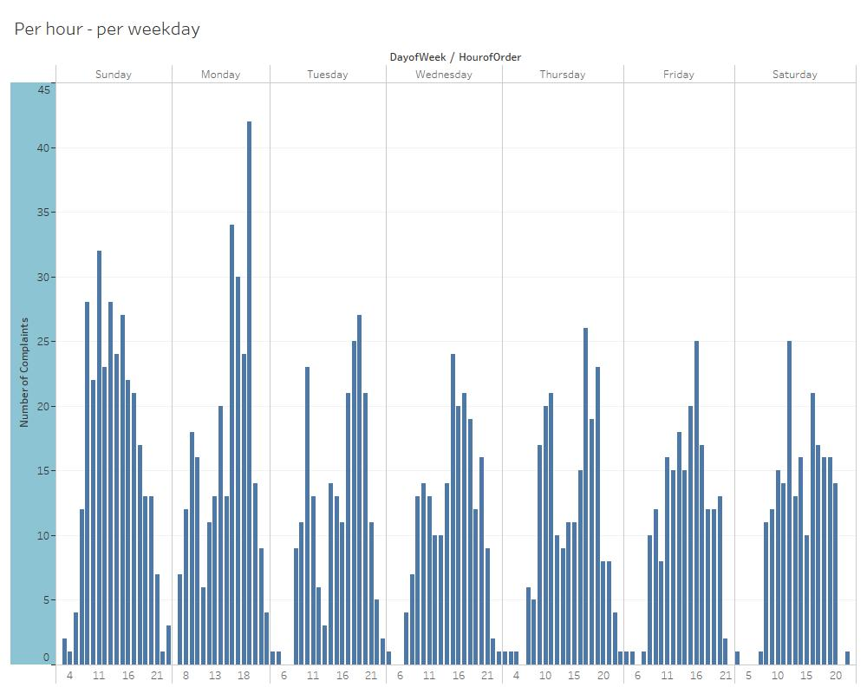
Distribution of Number of Complaints per hour per weekday

Slide 8
Customer Ratings analysis and Data cleaning process
Assumptions :
1) Since there are a lot of orders that don’t have a complaint and yet have a lesser rating, we cannot ignore them from analysis
2) The average customer rating for the orders that had complaints is approximately 3
3) The number of complaints were counted as follows :
If a complaint is registered for an order, then it is counted as 1
If an order has no complaint registered, but has a rating of 3, it is counted as a complaint
4) There is only single support center which handles the calls from every city in united states
Data Cleaning process :
1) All the data was given with respect to UTC . So, converted them to respective time-zone dates
2) Split the hours of day into 4 time periods:
Morning ( 7 AM to 12 PM)
Afternoon ( 12 PM to 4 PM)
Evening ( 4 PM to 10 PM)
Night (10 PM to 6 AM)
3) Created indicator variables for time periods and Weekdays

Slide 9
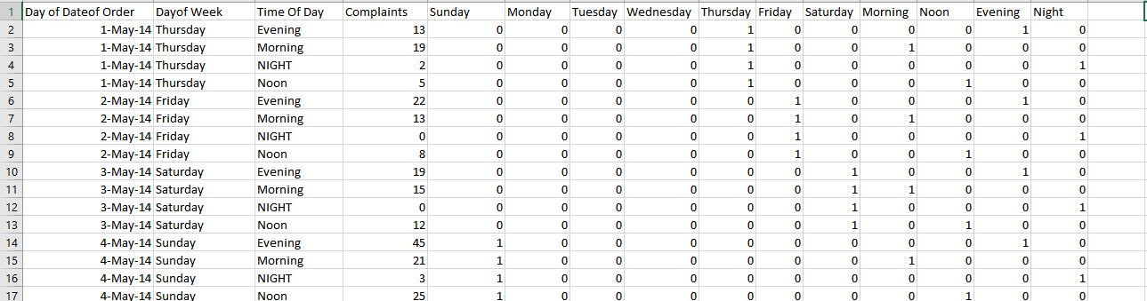
Customer Support Staffing Problem
In-order to solve the customer support staffing problem, we need to understand what are the peak days and peak hours of the business
Once, the data is cleaned and the number of complaints per day , per time span of day are calculated ,
the cleaned dataset looks as below

Slide 10
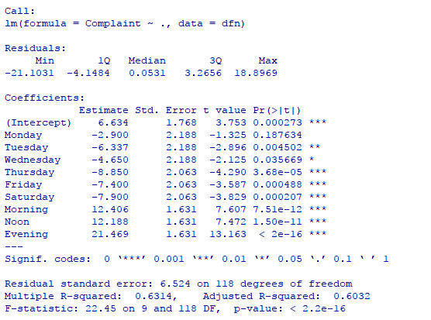
Regression Analysis Interpretation and Output
Since the number of orders / complaints differ from time span and day of week, we need to include variables in the model that can provide the difference/effect of the number of orders when compared to other days
Performed an Ordinary Least Squares Regression on the data and obtained the regression coefficients and statistics as shown.
From the regression intercepts, I have observed the same thing that was assumed, that number of complaints have negative coefficients from Monday to Saturday with baseline as Sunday.
Example interpretation of output : The number of complaints will decrease by a 2.9 on Monday when compared to Sunday and would go up by 12.4 if it is morning when compared to Night

Slide 11
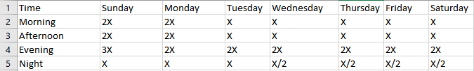
Conclusions and Strategy for staffing Customer Support team
Maximum number of concurrent complaints is 6 while majority of the times its 2
Assuming X to be the number of people in the shift on Sunday night, below are the approximate number of people needed in the shifts based on the given dataset.
Wrong item % during the evening times (4 – 10 PM) is very high which can be assumed to be because of higher number of orders per shopper. Business can focus on this problem to improve customer experience

Slide 12
THANK YOU !!

